Slide 1
CHALLENGE 2
#include

Slide 2
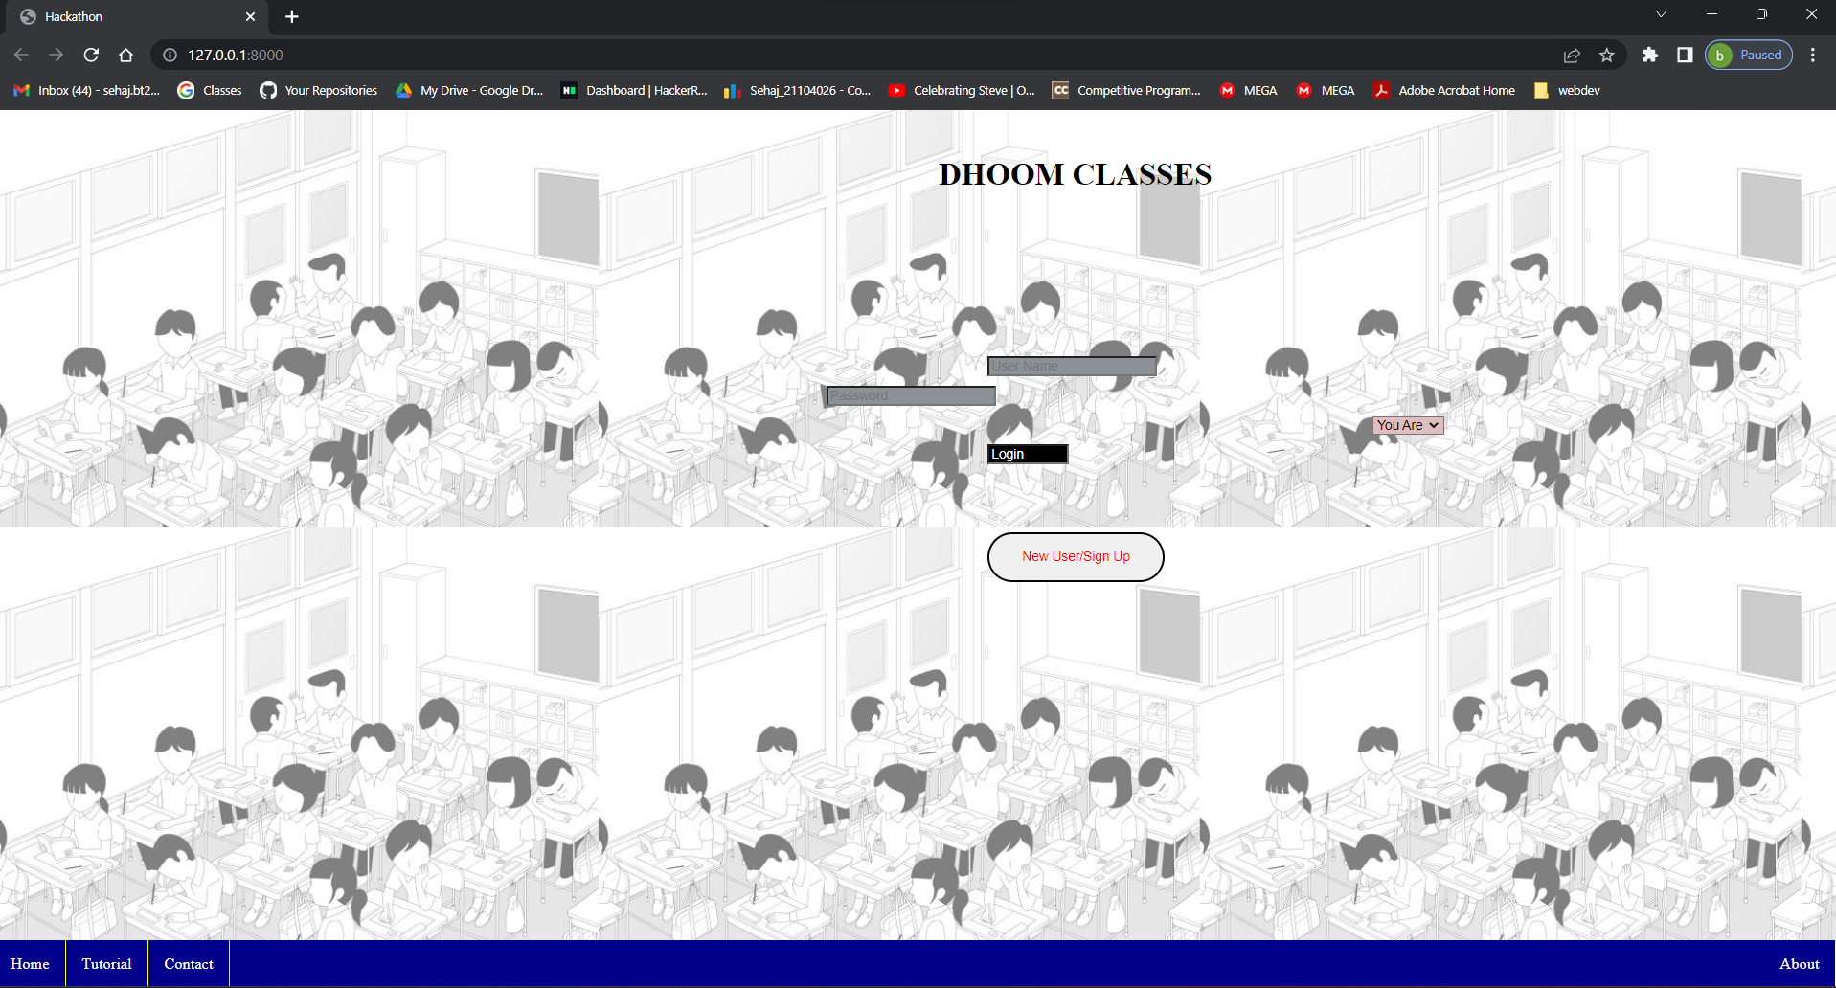

Slide 3
FRONTEND
Frontend was build with HTML, Javascript , CSS and Bootstrap.
The first page is the login page that has options of login and signup
After login the user will be able to access the feedback.

Slide 4
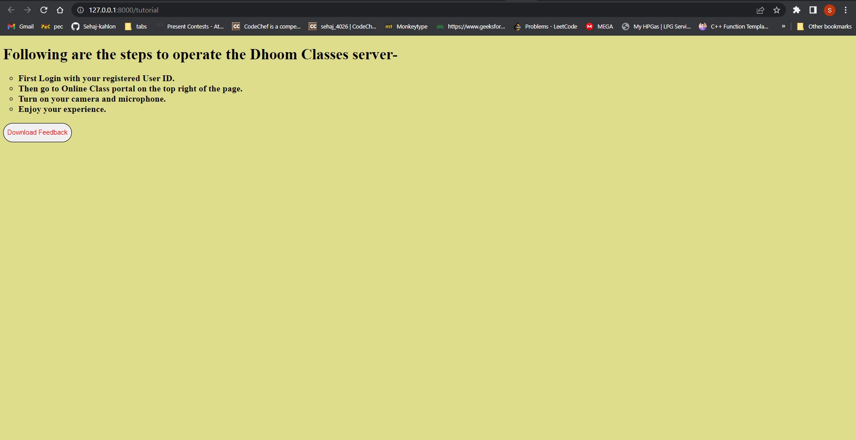

Slide 5
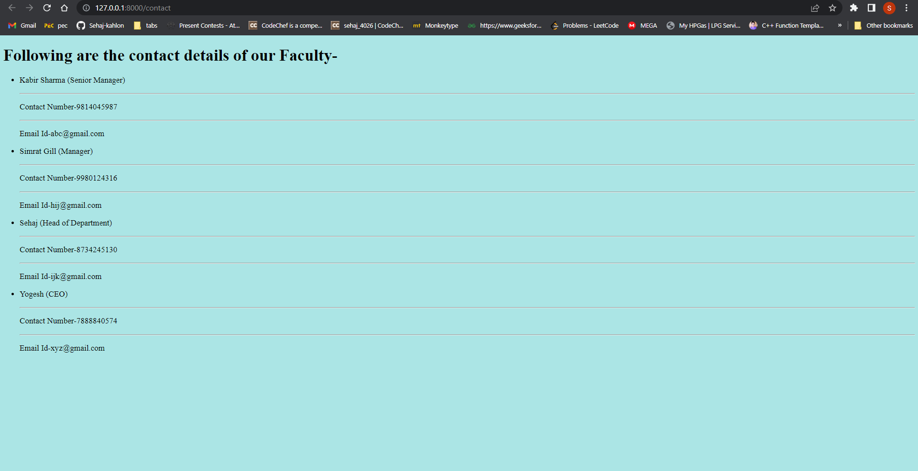

Slide 6
feedback
The feedback is such that whenever the user / student switches the tab during a meet / class the username and time of switching will be recorded and provided as feedback to the teachers as a table / excel sheet displayed on the screen.
Backend -
Backend is built on django
Database is made by sql
Tables are created for storing data
User name is treated as key value

Slide 7
- Harsimrat Kaur 21104122
- Sehaj 21104026
- Kabir Sharma 21104092
- Yogesh 21104122
-

